Slide 1

Community-Integrated Ambulance Network
- Team Ruby

Slide 2
Inefficient ambulance response times pose a critical challenge, often resulting in delays for individuals in need of urgent medical assistance. These delays stem from suboptimal route selection and inadequate communication between emergency services and drivers, leading to delayed arrival at the scene.
“
”

Slide 3
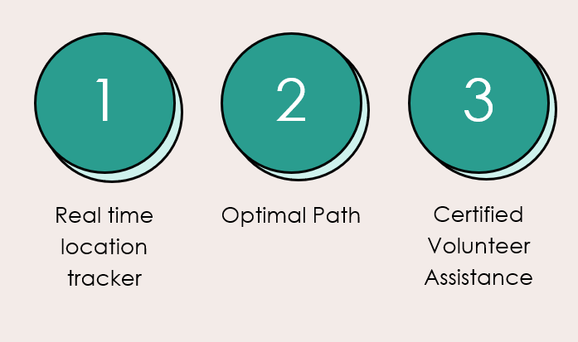
Features

Slide 4





Approach
Immediate Alert Generation
Upon detection of an accident, local people call the ambulance through our app, triggering an immediate response and signaling the need for assistance.
Real-time Incident Updates
Provide drivers with immediate updates on incident status, including ambulance arrival and estimated time of arrival, optimizing response coordination.
Volunteer Verification
Implement a verification process for volunteers, ensuring credibility and skillset alignment before deployment to emergency incidents, enhancing response effectiveness and user trust.
Incident Notifications for Volunteers
Volunteers receive real-time notifications about nearby incidents, enabling swift response and efficient deployment to provide assistance in emergencies.
Volunteers Confirm Availability
Volunteers acknowledge the alert and confirm their availability to respond to the emergency, indicating their willingness to provide assistance.

Slide 5
Thank you

